Slide 1
Attack Cards (Front)
1.1 (-1)
1.2 (-1)
1.3 (-1)
1.4 (-1)
Initial Recon: Excavation
Initial Recon: Interception
Initial Recon: Footprinting
Initial Recon: Protocol Analysis
An adversary actively probes the target in a manner that is designed to solicit information that could be leveraged for malicious purposes.
An adversary monitors data streams to or from the target for information gathering purposes.
An adversary engages in probing and exploring activities to identify constituents and properties of the target.
An adversary engages in activities to decipher and/or decode protocol information for a network or application communication protocol used for transmitting information between interconnected nodes or systems on a packet-switched data network.
1.5 (-1)
1.6 (-1)
2.1 (-1)
3.1 (-1)
Initial Recon: Fingerprinting
Initial Recon:
Information Elicitation
Acquire/Develop Tools
Delivery: Content Spoofing
An adversary compares output from a target system to known indicators that uniquely identify specific details about the target.
An adversary engages an individual using any combination of social engineering methods for the purpose of extracting information.
Attackers develop or acquire tools for efficient attacks.
An adversary modifies content to make it contain something other than what the original content producer intended while keeping the apparent source of the content unchanged.

Slide 2



Attack Cards (Back)
Attack Card
(Type B: Initial Recon)
Attack Card
(Type B: Initial Recon)
Attack Card
(Type B: Initial Recon)
Attack Card
(Type B: Initial Recon)
Attack Card
(Type B: Delivery)
Attack Card
(Type B: Acquire/Develop Tools)
Attack Card
(Type B: Initial Recon)
Attack Card
(Type B: Initial Recon)

Slide 3
Attack Cards (Front)
3.2 (-1)
3.3 (-1)
3.4 (-1)
3.5 (-1)
Delivery: Identity Spoofing
Delivery:
Resource Location Spoofing
Delivery: Action Spoofing
Delivery:
Manipulate Human Behavior
Identity Spoofing refers to the action of assuming (i.e., taking on) the identity of some other entity (human or non-human) and then using that identity to accomplish a goal.
An adversary deceives an application or user and convinces them to request a resource from an unintended location.
An adversary is able to disguise one action for another and therefore trick a user into initiating one type of action when they intend to initiate a different action.
An adversary exploits inherent human psychological predisposition to influence a targeted individual or group to solicit information or manipulate the target into performing an action that serves the adversary's interests.
3.6 (-1)
3.7 (-1)
3.8 (-1)
3.9 (-1)
Delivery:
Drive-by Compromise
Delivery: Exploit Public-Facing Application
Delivery:
Hardware Additions
Delivery: Replication Through Removable Media
A drive-by compromise is when an adversary gains access to a system through a user visiting a website over the normal course of browsing.
The use of software, data, or commands to take advantage of a weakness in an Internet-facing computer system or program in order to cause unintended or unanticipated behavior.
While public references of usage by APT groups are scarce, many penetration testers leverage hardware additions for initial access.
Adversaries may move onto systems, possibly those on disconnected or air-gapped networks, by copying malware to removable media and taking advantage of Autorun features when the media is inserted into a system and executes.

Slide 4
Attack Cards (Back)
Attack Card
(Type B: Delivery)
Attack Card
(Type B: Delivery)
Attack Card
(Type B: Delivery)
Attack Card
(Type B: Delivery)
Attack Card
(Type B: Delivery)
Attack Card
(Type B: Delivery)
Attack Card
(Type B: Delivery)
Attack Card
(Type B: Delivery)

Slide 5
Attack Cards (Front)
3.10 (-1)
3.11 (-1)
3.12 (-1)
4.1 (-2)
Delivery:
Spear phishing
Delivery:
Supply Chain Compromise
Delivery:
Valid Accounts
Initial Compromise: Defense Evasion (Binary Padding)
Adversaries attach a file or a link to the spear phishing email and usually rely upon User Execution to gain execution.
Or adversaries send messages through various social media services, personal webmail, and other non-enterprise controlled services.
Supply chain compromise is the manipulation of products or product delivery mechanisms prior to receipt by a final consumer for the purpose of data or system compromise.
Adversaries may steal the credentials of a specific user or service account using Credential Access techniques or capture credentials earlier in their reconnaissance process through social engineering for means of gaining Initial Access.
Adversaries may add data to files to increase the size beyond what security tools are capable of handling or to change the file hash to avoid hash-based blacklists.
4.2 (-2)
4.3 (-2)
4.4 (-2)
4.5 (-2)
Initial Compromise:
Defense Evasion
Initial Compromise:
Defense Evasion
Initial Compromise:
Defense Evasion
Initial Compromise:
Defense Evasion
Adversaries may clear the command operation history and hide the file, etc. so as not to discover himself.
- history –c
- File Deletion (DEL command)
- Hidden Files (attrib +h) …
Adversaries may abuse OS and application functions to avoid detection by security tools.
- CMSTP.exe
- Compiled HTML files (.chm)
- DLL Search Order Hijacking
- Extra Window Memory
- DACLs
- Image File Execution Options
Adversaries may attempt to make an executable or file difficult to discover or analyze by encrypting, encoding, or otherwise obfuscating its contents on the system or in transit.
Adversaries may utilize timestomping that is a technique that modifies the timestamps of a file (the modify, access, create, and change times), often to mimic files that are in the same folder.

Slide 6
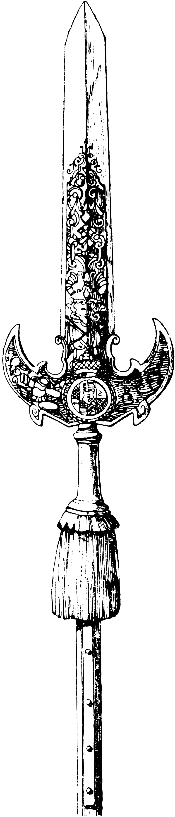
Attack Cards (Back)
Attack Card
(Type B: Initial Compromise)
Attack Card
(Type B: Delivery)
Attack Card
(Type B: Delivery)
Attack Card
(Type B: Delivery)
Attack Card
(Type B: Initial Compromise)
Attack Card
(Type B: Initial Compromise)
Attack Card
(Type B: Initial Compromise)
Attack Card
(Type B: Initial Compromise)

Slide 7
Attack Cards (Front)
4.6 (-2)
4.7 (-2)
4.8 (-2)
4.9 (-2)
Initial Compromise:
Defense Evasion
Initial Compromise:
Defense Evasion
Initial Compromise:
Defense Evasion
Initial Compromise:
Defense Evasion
Adversaries may disable security tools to avoid possible detection of their tools and activities.
Adversaries are known to use code signing certificates to masquerade malware and tools as legitimate binaries.
Code signing certificates may be used to bypass security policies that require signed code to execute on a system.
Vulnerabilities may exist in defensive security software that can be used to disable or circumvent them.
Adversaries may delete or alter generated artifacts on a host system, including logs and potentially captured files such as quarantined malware.
Or block indicators or events typically captured by sensors from being gathered and analyzed.
4.10 (-2)
4.11 (-2)
4.12 (-2)
4.13 (-2)
Initial Compromise:
Defense Evasion
Initial Compromise:
Defense Evasion
Initial Compromise: Execution
Initial Compromise: Execution
Adversaries may use Obfuscated Files or Information to hide artifacts of an intrusion from analysis.
- Scripting
- PowerShell
- Utilities present on the system
Adversaries may use rootkits to hide the presence of programs, files, network connections, services, drivers, and other system components.
Adversaries may exploit many utilities used for software development related tasks that can be used to execute code in various forms to assist in development, debugging, and reverse engineering.
- MSBuild
- WinDbg/CDB
- Tracker …
Adversaries may gain access to and use third-party application deployment systems installed within an enterprise network.

Slide 8
Attack Cards (Back)
Attack Card
(Type B: Initial Compromise)
Attack Card
(Type B: Initial Compromise)
Attack Card
(Type B: Initial Compromise)
Attack Card
(Type B: Initial Compromise)
Attack Card
(Type B: Initial Compromise)
Attack Card
(Type B: Initial Compromise)
Attack Card
(Type B: Initial Compromise)
Attack Card
(Type B: Initial Compromise)

Slide 9
Attack Cards (Front)
4.14 (-2)
5.1 (-3)
5.2 (-3)
5.3 (-3)
Initial Compromise: Execution
Misuse/Escalate Privilege
Misuse/Escalate Privilege
Misuse/Escalate Privilege
Adversaries may exploits the functions and mechanisms of the OS and application used by the system.
- CMSTP.exe, API, DLL
- Command-line tools
- .chm, Task Scheduler
- Dynamic Data Exchange
- PowerShell …
Adversaries may exploit vulnerabilities of Dynamic Link Library (DLLs) to gain privilege escalation and persistence.
- Windows DLL search order
- AppInit_DLLs value
- AppCert DLLs
- SID-History Injection
Adversaries may exploit file system permissions weakness to replace legitimate binaries with malicious ones as a means of executing code at a higher permissions level.
If the permissions for users and groups are not properly set and allow access to the Registry keys for a service, then adversaries can change the service binPath/ImagePath to point to a different executable under their control.
5.4 (-3)
5.5 (-3)
5.6 (-3)
6.1 (-3)
Misuse/Escalate Privilege
Misuse/Escalate Privilege
Misuse/Escalate Privilege
Internal Recon:
Credential Access
Adversaries can exploit credential management and access technology to gain privilege escalation.
- Access Token Manipulation
- Bypass User Account Control
- Sudo Caching
- Utilize valid Accounts
Adversaries may exploit OS or application functions or vulnerabilities to escalate privilege.
- Web Shell
- Extra Window Memory Injection
- Application Shimming
Adversaries can utilize process injection that is a method of executing arbitrary code in the address space of a separate live process to access to elevated privileges.
Adversaries may search local file systems and remote file shares for files containing passwords.
Ex.)
Credential dumping: Mimikatz

Slide 10

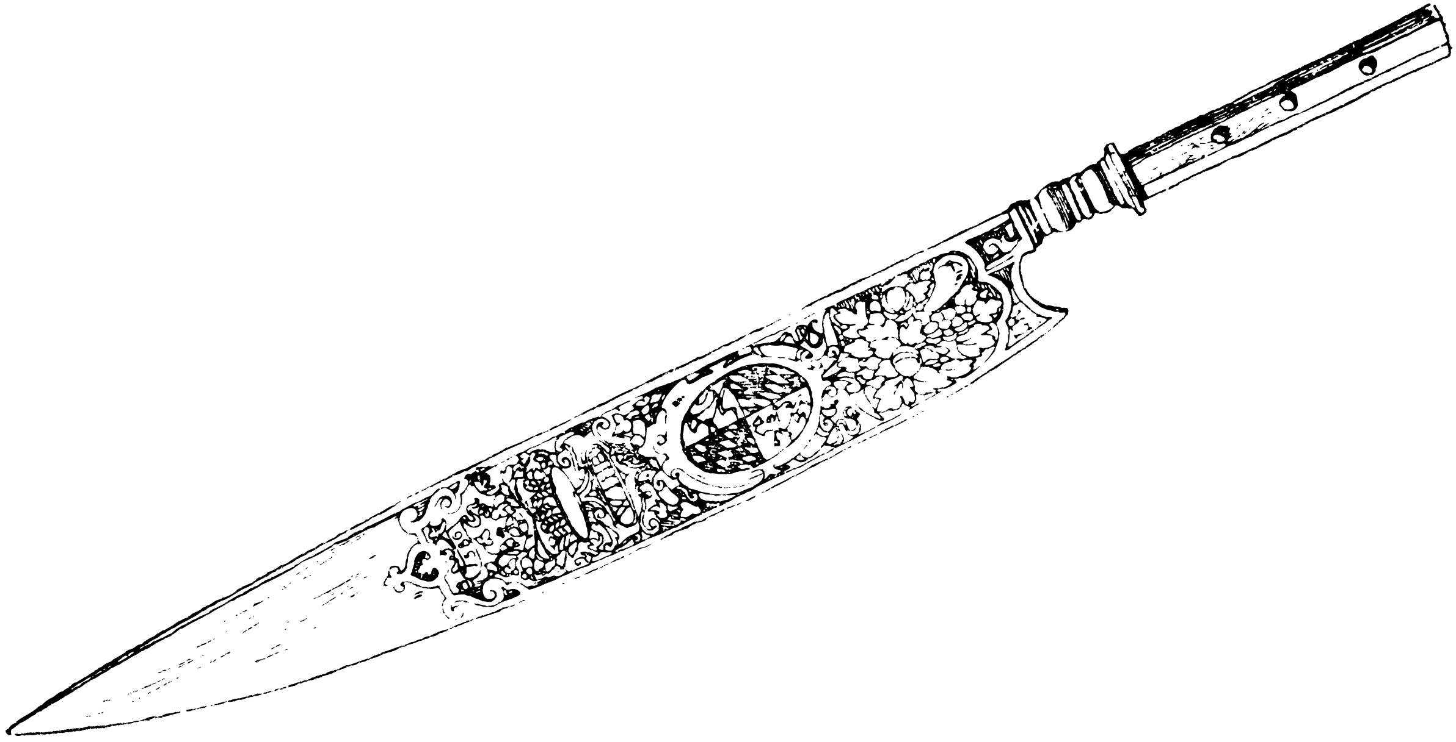
Attack Cards (Back)
Attack Card
(Type B: Misuse/Escalate Privilege)
Attack Card
(Type B: Misuse/Escalate Privilege)
Attack Card
(Type B: Misuse/Escalate Privilege)
Attack Card
(Type B: Initial Compromise)
Attack Card
(Type B: Internal Recon)
Attack Card
(Type B: Misuse/Escalate Privilege)
Attack Card
(Type B: Misuse/Escalate Privilege)
Attack Card
(Type B: Misuse/Escalate Privilege)

Slide 11
Attack Cards (Front)
6.2 (-3)
6.3 (-3)
6.4 (-3)
6.5 (-3)
Internal Recon:
Credential Access
Internal Recon:
Credential Access
Internal Recon:
Credential Access
Internal Recon:
Credential Access
An adversary may place a network interface into promiscuous mode to passively access data in transit over the network, or use span ports to capture a larger amount of data.
Adversaries may use brute force techniques to attempt access to accounts when passwords are unknown or when password hashes are obtained.
Adversaries may use account manipulation that could consist of modifying permissions, modifying credentials, adding or changing permission groups, modifying account settings, or modifying how authentication is performed.
Adversaries may gather private keys from compromised systems for use in authenticating to Remote Services like SSH or for use in decrypting other collected files such as email.
6.6 (-3)
6.7 (-3)
6.8 (-3)
6.9 (-3)
Internal Recon:
Credential Access
Internal Recon: Discovery
Internal Recon: Discovery
Internal Recon: Discovery
Adversaries may exploit vulnerability of authentication mechanism or OS to gain credentials and access.
- SMB
- Keychains
- Hooking
- LLMNR/NBT-NS Poisoning
Adversaries may interact with the Windows Registry to gather information about the system, configuration, and installed software.
Adversaries may attempt to gather information about attached peripheral devices and components connected to a computer system.
Adversaries may discover the information using commands.
- Account: net user,
- Directory: dir,
- Network Share: net share,
- Password Policy: net accounts,
- Process: tasklist,
- Remote System: ping,
- System Time: net time,
etc…

Slide 12
Attack Cards (Back)
Attack Card
(Type B: Internal Recon)
Attack Card
(Type B: Internal Recon)
Attack Card
(Type B: Internal Recon)
Attack Card
(Type B: Internal Recon)
Attack Card
(Type B: Internal Recon)
Attack Card
(Type B: Internal Recon)
Attack Card
(Type B: Internal Recon)
Attack Card
(Type B: Internal Recon)

Slide 13
Attack Cards (Front)
6.10 (-3)
7.1 (-4)
7.2 (-4)
7.3 (-4)
Internal Recon: Discovery
Lateral Movement
Lateral Movement
Lateral Movement
Adversaries may attempt to get a listing of services running on remote hosts, including those that may be vulnerable to remote software exploitation. Methods to acquire this information include port scans and vulnerability scans using tools that are brought onto a system.
Adversaries can exploit authentication mechanism in the system and infringe the system or another system on the network.
(Login Scripts, Pass the Hash, Pass the ticket)
Adversaries may move onto systems, possibly those on disconnected or air-gapped networks, by copying malware to removable media and taking advantage of Autorun features when the media is inserted into a system and executes.
Adversaries may deploy malicious software to systems within a network using application deployment systems employed by enterprise administrators.
7.4 (-4)
7.5 (-4)
7.6 (-4)
8.1 (-4)
Lateral Movement
Lateral Movement
Lateral Movement
Establish Persistence
Adversaries can exploit the functions and mechanisms of OS and applications used by targets and expand system infringement.
(AppleScript, DCOM, RDP, FTP, scp, SSH, RPC, )
Adversaries may use tainted shared content to move laterally.
Once a user opens the shared tainted content, the malicious portion can be executed to run the adversary's code on a remote system.
Adversaries may add malicious content to an internally accessible website through an open network file share that contains the website's webroot or Web content directory and then browse to that content with a Web browser to cause the server to execute the malicious content.
Adversaries can use some commands to their advantage to hide files and folders anywhere on the system for persistence and evading a typical user or system analysis that does not incorporate investigation of hidden files.

Slide 14


Attack Cards (Back)
Attack Card
(Type B: Lateral Movement)
Attack Card
(Type B: Lateral Movement)
Attack Card
(Type B: Lateral Movement)
Attack Card
(Type B: Internal Recon)
Attack Card
(Type B: Establish Persistence)
Attack Card
(Type B: Lateral Movement)
Attack Card
(Type B: Lateral Movement)
Attack Card
(Type B: Lateral Movement)

Slide 15
Attack Cards (Front)
8.2 (-4)
8.3 (-4)
8.4 (-4)
8.5 (-4)
Establish Persistence
Establish Persistence
Establish Persistence
Establish Persistence
Some adversaries may employ sophisticated means to compromise computer components and install malicious firmware that will execute adversary code outside of the operating system and main system firmware or BIOS.
Adversaries may add a malicious process or script that runs when the OS or application start up.
- Startup Items
- Logon Scripts
- Office Application Startup
- Login Item
- LSASS Driver
- Web Shell …
Adversaries may may exploit OS and application functions to ensure persistence to system access.
- BITS
- Browser Extensions
- Loadable Kernel Modules
- Scheduled Task
Adversaries may use rootkits to persist on systems at a layer below the operating system, which may make it difficult to perform full remediation unless an organization suspects one was used and can act accordingly.
8.6 (-4)
8.7 (-4)
9.1 (-5)
9.2 (-5)
Establish Persistence
Establish Persistence
Execute Mission Objectives: Collection
Execute Mission Objectives: Collection
Adversaries may use more than one remote access tool with varying command and control protocols as a hedge against detection.
- VPNs
- Citrix
Adversaries with a sufficient level of access may create a local system or domain account. Such accounts may be used for persistence that do not require persistent remote access tools to be deployed on the system.
An adversary can capture audio recordings, video recordings, clipboard, screen captures and user input with available a computer's APIs and peripheral devices to gather information.
Once established within a system or network, an adversary may use automated techniques for collecting internal data.

Slide 16

Attack Cards (Back)
Attack Card
(Type B: Establish Persistence)
Attack Card
(Type B: Establish Persistence)
Attack Card
(Type B: Establish Persistence)
Attack Card
(Type B: Establish Persistence)
Attack Card
(Type B: Execute Mission Objectives)
Attack Card
(Type B: Execute Mission Objectives)
Attack Card
(Type B: Establish Persistence)
Attack Card
(Type B: Establish Persistence)

Slide 17
Attack Cards (Back)
Attack Card
(Type B: Execute Mission Objectives)
Attack Card
(Type B: Execute Mission Objectives)
Attack Card
(Type B: Execute Mission Objectives)
Attack Card
(Type B: Execute Mission Objectives)
Attack Card
(Type B: Execute Mission Objectives)
Attack Card
(Type B: Execute Mission Objectives)
Attack Card
(Type B: Execute Mission Objectives)
Attack Card
(Type B: Execute Mission Objectives)

Slide 18
Attack Cards (Front)
9.3 (-5)
9.4 (-5)
9.5 (-5)
9.6 (-5)
Execute Mission Objectives: Collection
Execute Mission Objectives: Collection (Man in the Browser)
Execute Mission Objectives: Collection (Data Staged)
Execute Mission Objectives: Exfiltration
Adversaries can search the file system, network shares, connected removable media on computers, information repositories they have compromised to find files of interest.
Adversaries can take advantage of security vulnerabilities and inherent functionality in browser software to change content, modify behavior, and intercept information as part of various man in the browser techniques.
Collected data is staged in a central location or directory prior to Exfiltration. Data may be kept in separate files or combined into one file through techniques such as Data Compressed or Data Encrypted.
An adversary may exfiltrate data in fixed size chunks, compress and encrypt in order to minimize the amount of data sent over the network, hide the information.
9.7 (-5)
9.8 (-5)
9.9 (-5)
9.10 (-5)
Execute Mission Objectives: Exfiltration
Execute Mission Objectives: Exfiltration
Execute Mission Objectives: Command and Control
Execute Mission Objectives: Command and Control
Data exfiltration is performed over the Command and Control channel.
Or It is preformed with a different protocol or a different network medium from the command and control protocol or channel.
Data exfiltration may be performed only at certain times of day or at certain intervals. This could be done to blend traffic patterns with normal activity or availability.
Adversaries can perform command and control between compromised hosts on potentially disconnected networks using removable media to transfer commands from system to system.
Adversaries may communicate over a commonly used port to bypass firewalls or network detection systems and to blend with normal network activity to avoid more detailed inspection.

Slide 19
Attack Cards (Back)
Attack Card
(Type B: Execute Mission Objectives)
Attack Card
(Type B: Execute Mission Objectives)
Attack Card
(Type B: Execute Mission Objectives)
Attack Card
(Type B: Execute Mission Objectives)
Attack Card
(Type B: Execute Mission Objectives)
Attack Card
(Type B: Execute Mission Objectives)
Attack Card
(Type B: Execute Mission Objectives)
Attack Card
(Type B: Execute Mission Objectives)

Slide 20
Attack Cards (Front)
9.11 (-5)
9.12 (-5)
9.13 (-5)
9.14 (-5)
Execute Mission Objectives: Command and Control
Execute Mission Objectives: Command and Control
Execute Mission Objectives: Command and Control
Execute Mission Objectives: Command and Control
Adversaries may conduct C2 communications over a non-standard port to bypass proxies and firewalls that have been improperly configured.
Some adversaries may split communications between different protocols. There could be one protocol for inbound command and control and another for outbound data, allowing it to bypass certain firewall restrictions.
Adversaries may use fallback or alternate communication channels if the primary channel is compromised or inaccessible in order to maintain reliable command and control and to avoid data transfer thresholds.
Adversaries may use a custom cryptographic protocol or algorithm, encoder, obfuscator, multiple stages, multiple layers of encryption, multiple proxies, to hide command and control traffic.
9.15 (-5)
9.16 (-5)
9.17 (-5)
9.18 (-5)
Execute Mission Objectives: Command and Control
Execute Mission Objectives: Command and Control
Execute Mission Objectives: Command and Control
Execute Mission Objectives: Command and Control
Adversaries may explicitly employ a known encryption algorithm to conceal command and control traffic rather than relying on any inherent protections provided by a communication protocol.
Adversaries may use an existing, legitimate external Web service as a means for relaying commands to a compromised system.
An adversary may use legitimate desktop support and remote access software, such as Team Viewer, Go2Assist, LogMein, AmmyyAdmin, etc, to establish an interactive command and control channel to target systems within networks.
Adversaries could use proxy to manage command and control communications, to reduce the number of simultaneous outbound network connections or to ride over existing trusted communications paths between victims to avoid suspicion.

Slide 21
Attack Cards (Back)
Attack Card
(Type B: Execute Mission Objectives)
Attack Card
(Type B: Execute Mission Objectives)
Attack Card
(Type B: Execute Mission Objectives)
Attack Card
(Type B: Execute Mission Objectives)
Attack Card
(Type B: Execute Mission Objectives)
Attack Card
(Type B: Execute Mission Objectives)
Attack Card
(Type B: Execute Mission Objectives)
Attack Card
(Type B: Execute Mission Objectives)

